Slide 1
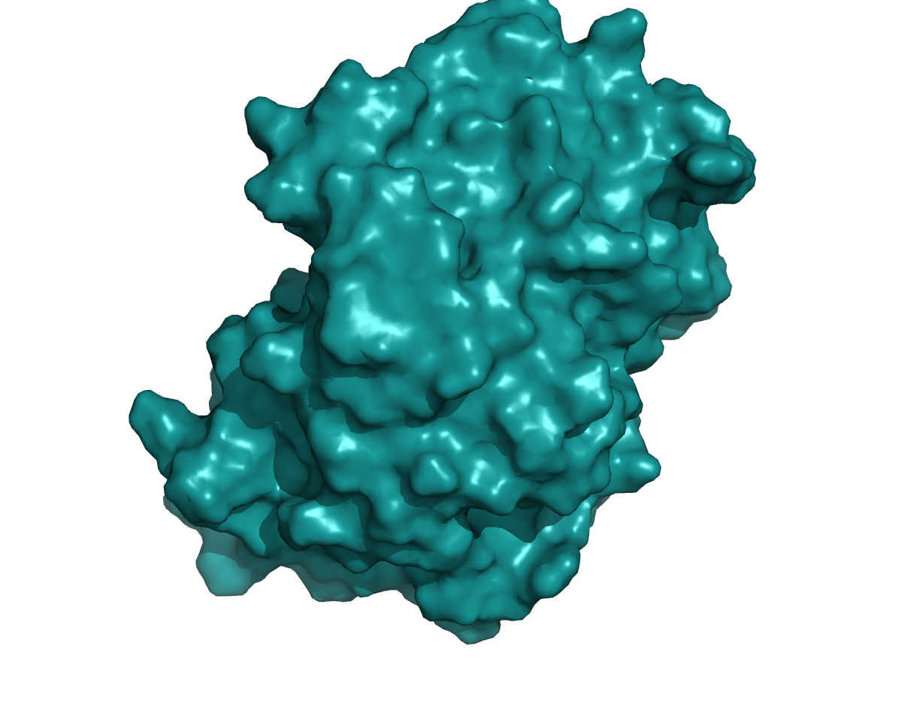
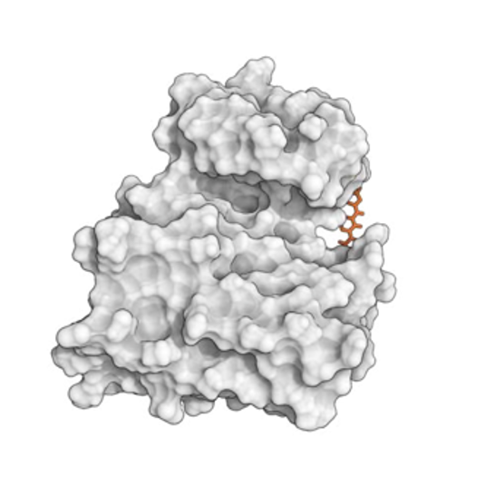
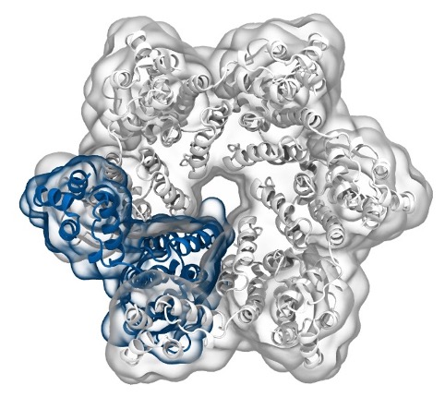
Simulation of Biomolecules
Lecture 4:
Setting up a protein simulation
2023 CCP5 Summer School
Dr Matteo Degiacomi
Durham University
matteo.t.degiacomi@durham.ac.uk
Dr Antonia Mey
University of Edinburgh
antonia.mey@ed.ac.uk

Slide 2
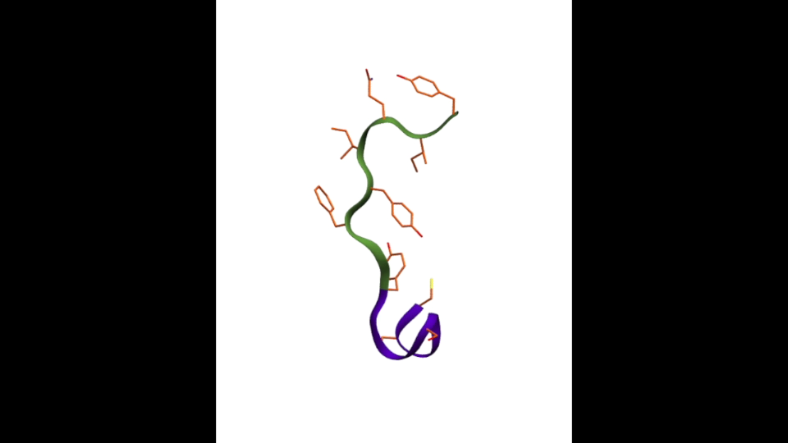
You will not run any MD simulation today, but you will learn how to set one up and how to analyse it

Slide 3
Part I: Steps and considerations needed when setting up a simulation

Slide 4
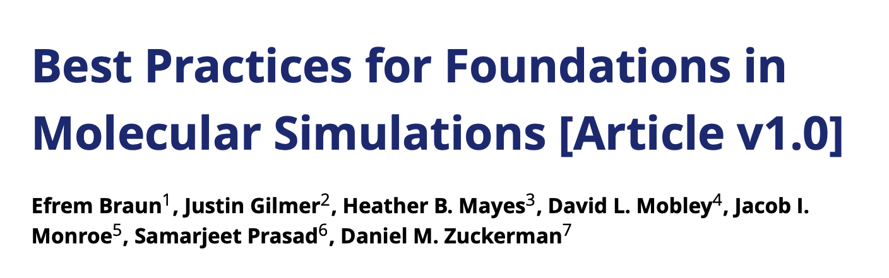
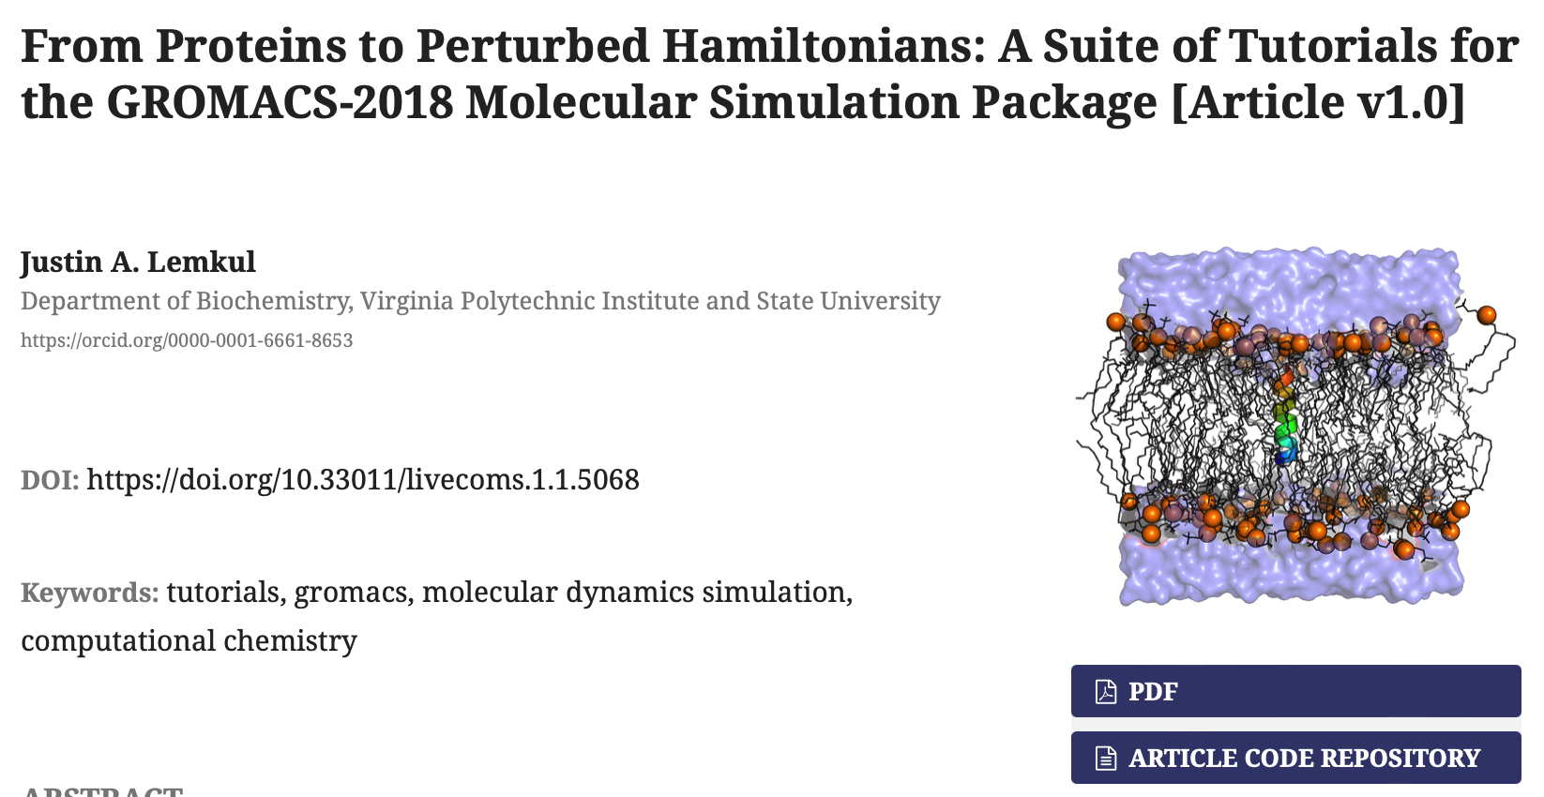

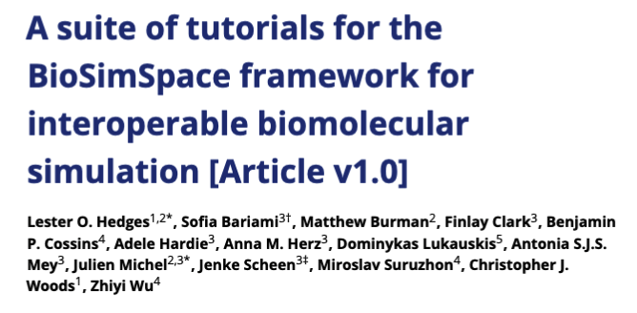

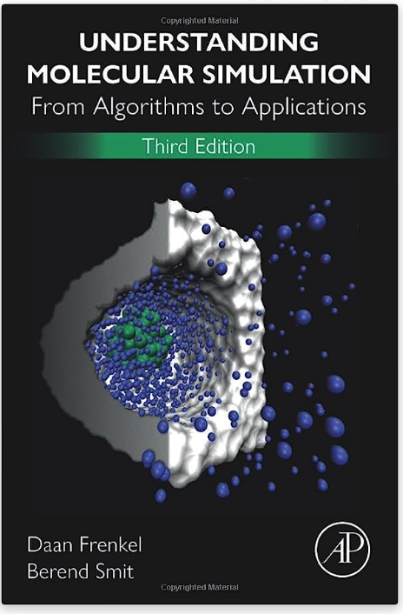
Useful resources to learn running simulations
Living J. Comp. Mol. Sci. 2019, 1, 5957

Slide 5
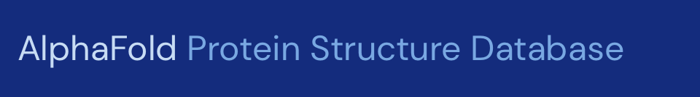

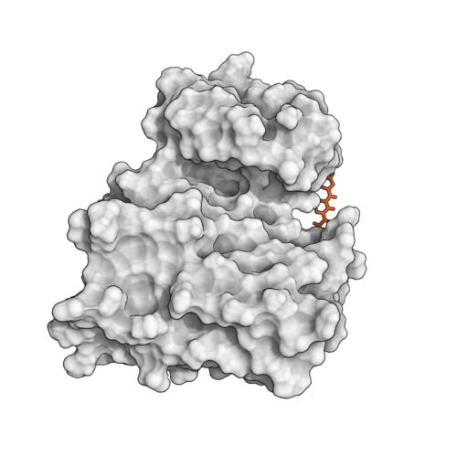
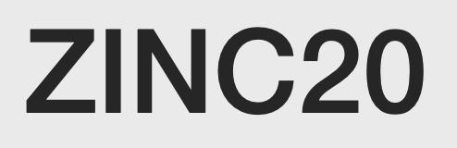

Starting point for setting up a simulation
Getting your protein structure
Prepping your protein and/or ligand(s)
Getting ready for your simulation…
Getting ligands/co-factors

Slide 6
A typical workflow for molecular dynamics
Get protein structure
Prep for simulation
Simulation setup
Gromacs
OpenMM
Python API
Run Simulation Protocol
Amber
NAMD
DLPoly
SOMD
Charmm
mostly C++
commandline
BioSimSpace
[…]
Simulation Analysis

Slide 7
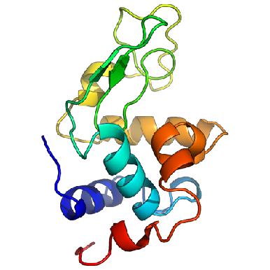
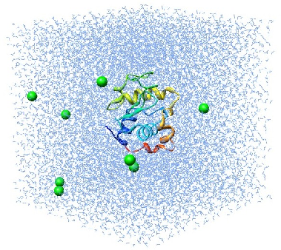
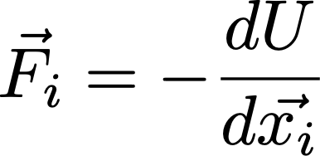
Molecular dynamics require multiple steps for the setup of simulations
Disulphide bridges
Protonation
Solvate in water and add ions
Crystal Waters
Cofactors
Alternative side chains
Solvated protein
Apply forcefield description
NVT/NPT equilibration
Minimize the positions
Equilibrated system
Solvated protein + forcefield
minimized protein
Production simulation
http://www.bevanlab.biochem.vt.edu/Pages/Personal/justin/gmx-tutorials/lysozyme/01_pdb2gmx.html
Levitt, Nature Structural Biology, 8, 392–393(2001)

Slide 8

There are many different choices for force fields to be made
Small molecule force fields
GAFF
Proteins and other constituents need different force fields
Machine learned force fields
Amber (Peter Kollmann, UCSF) –Glycam parameters cover most sugars (Robert J. Woods, University of Georgia)
CHARMM (Martin Karplus, Harvard) –POPC, POPE, DPPC lipids
OPLS (William Jorgensen, Yale)
GROMOS (Wilfried van Gunsteren, ETHZ)
SchNet
Ani-2x
PhysNet
BandNN
Espaloma
Coarse-grained force fields….
There is no “best force field”!

Slide 9
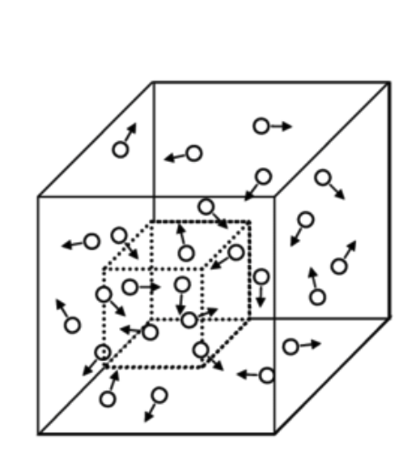
Choosing your thermodynamic ensemble
Simulations replicate a specific thermodynamic ensemble (typically NVT or NPT), or even grand canonical (μVT)
You will have different options to include thermostats (scaling atom velocities) and barostats (scaling positions) in your calculations:
Nose-Hoover
Berendsen
Parrinello-Rahman
Langevin piston
…
μVT
NVT/NPT equilibration
Minimize the positions
Equilibrated system
Solvated protein + forcefield
minimized protein

Slide 10
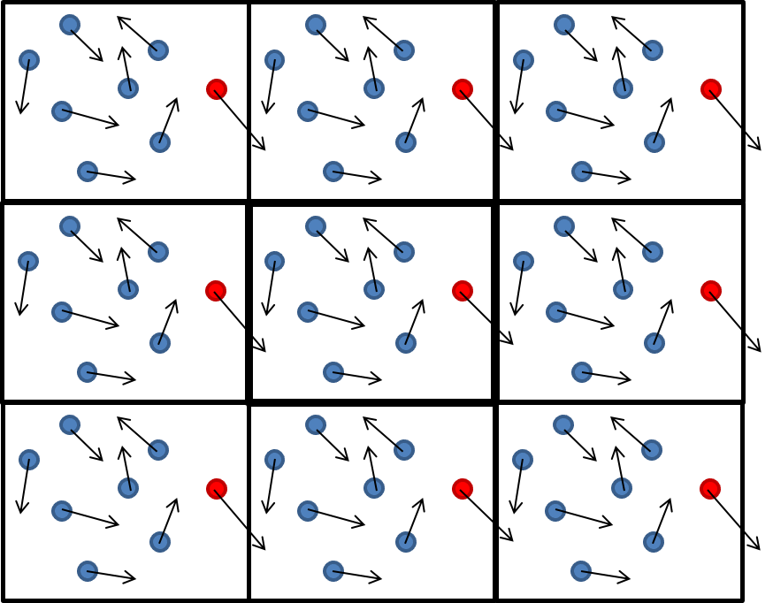
Periodic boundary conditions and pressure coupling
If you want to simulate membrane systems you want to chose semi-isotropic pressure coupling!
Typically you chose periodic boundary conditions in x-y-z.

Slide 11
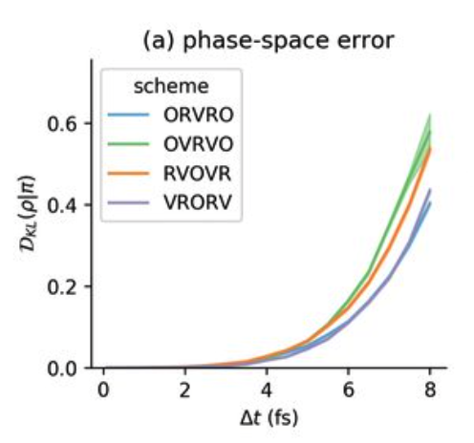
Sampling timescales for protein systems
The steepest gradient determines the smallest timestep:
Timestep size is imposed by the fastest phenomenon we want to observe :
Covalent bond hydrogen-heavy atom (10¹⁴ Hz): 0.5 fs
Covalent bond heavy atom-heavy atom: 1 fs
Angles fluctuations: 2 fs
Restraining covalent bond distances allows to use 1-2 fs timesteps (restraining methods: SHAKE, RATTLE, LINCS,…)
Hydrogen Mass repartitioning: 4 fs
Other integrators: 4 fs- 6 fs.

Slide 12
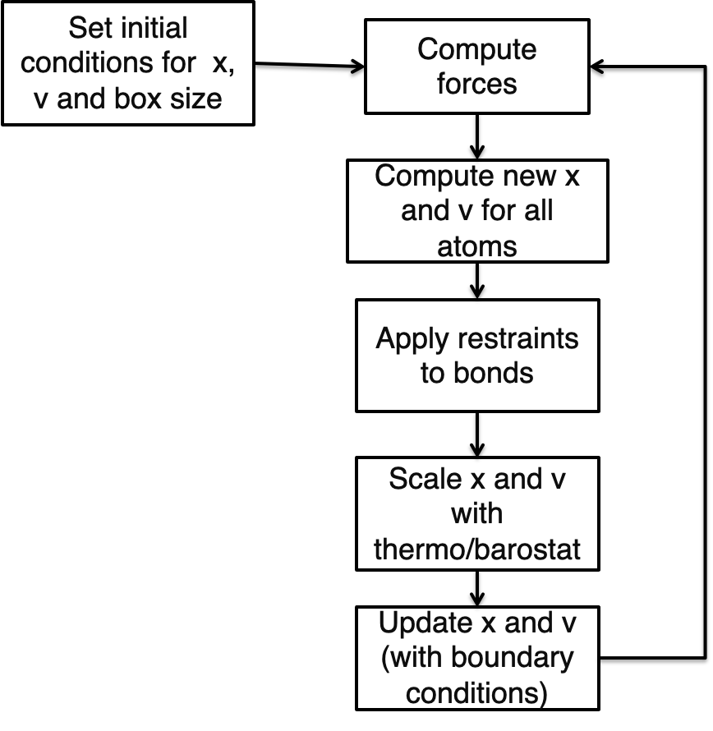
An actual MD timestep

Slide 13
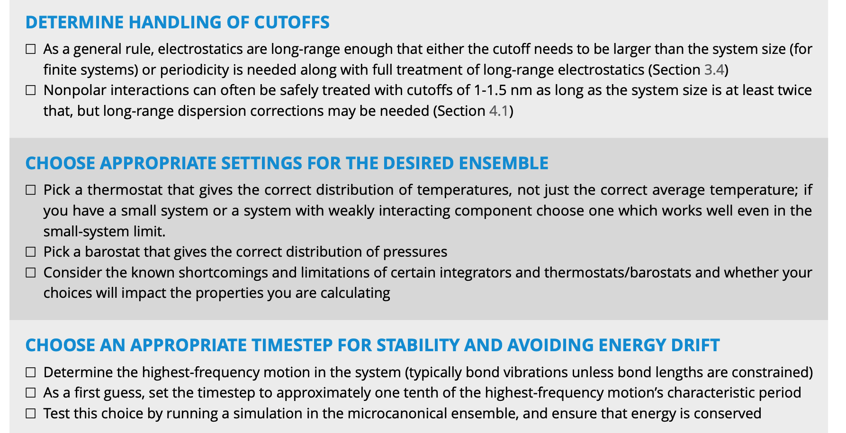
An example MD protocol
AIM: equilibrate your system
YOU WANT: constant volume, pressure and temperature, stable Root Mean Square Deviation, healthy Ramachandran plot, no exotic chemistry, bulk water (if used), stabilization of whichever other quantity you are interested about (e.g. Rgyr, …)
Example:
Minimize energy, 1000 steepest descent
Heat system from 0 to 300 K in 500 ps, NPT, Berendsen barostat 1 atm. α-carbon restrained with 10 Kcal/mol harmonic potential. 2 fs timestep, SHAKE all bonds,
1 ns nVT equilibration with Langevin dynamics, no atom constrained.
Production: 200 ns NPT, Nose-Hoover barostat, PME for electrostatics
Living J. Comp. Mol. Sci. 2019, 1, 5957

Slide 14

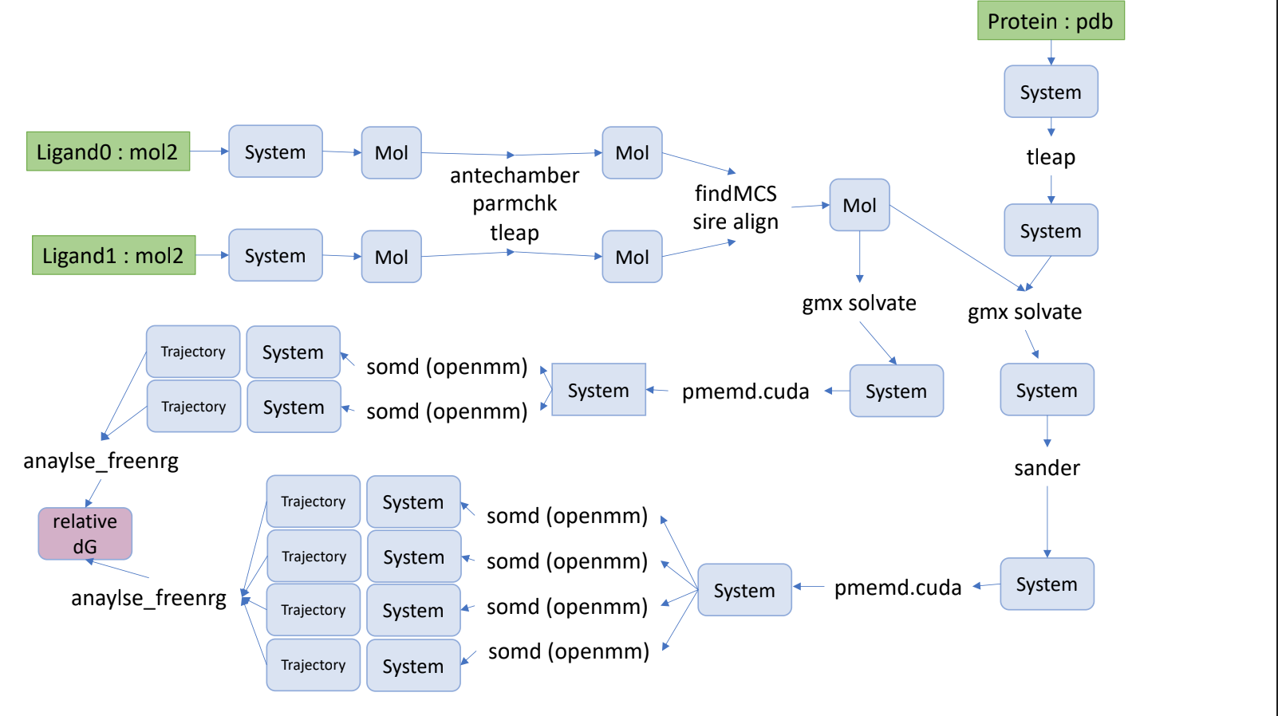
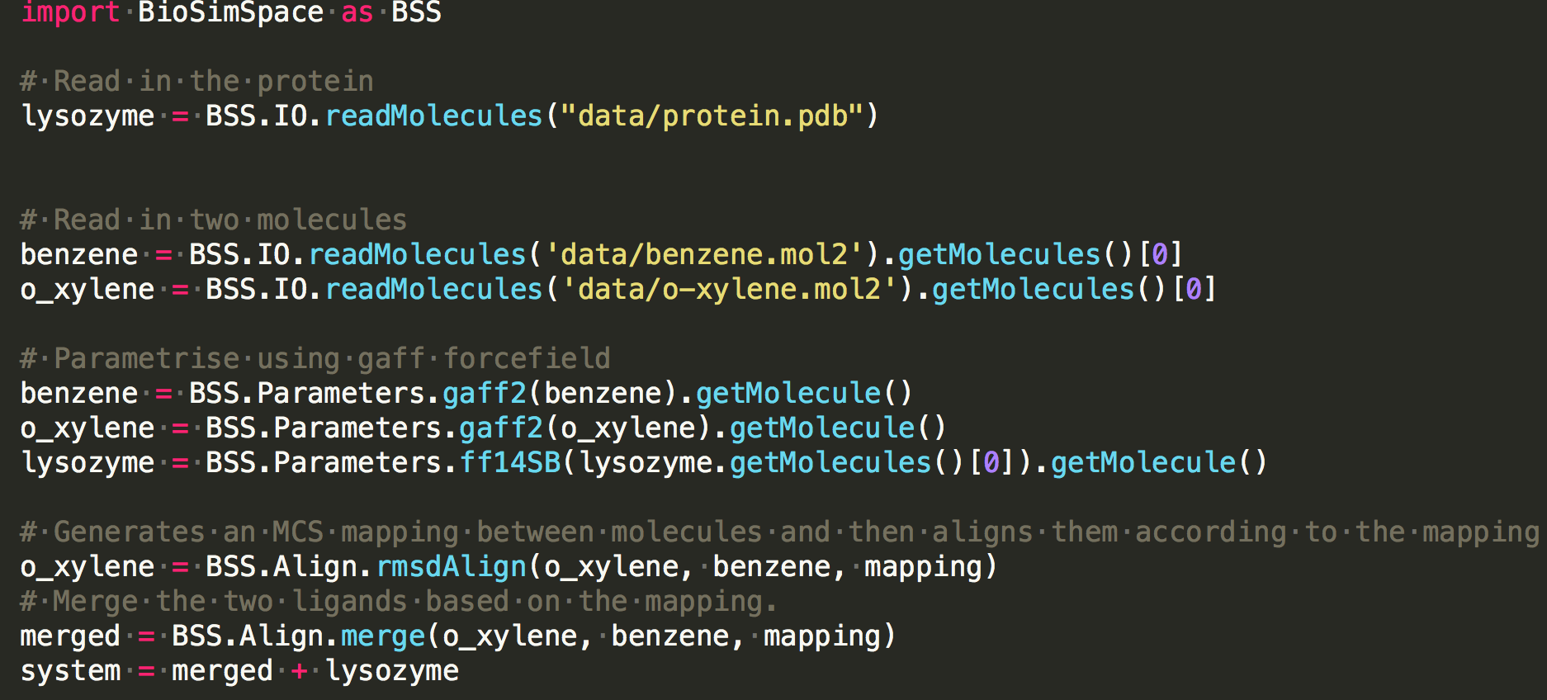
BioSimSpace simplifies complex workflows in a single Python script

Slide 15
Let’s try setting up a simulation with BioSimSpace

Slide 16
Part II: Steps and considerations needed when setting up a simulation
Some of the material presented here is adapted from Prof. Charlie Laughton

Slide 17
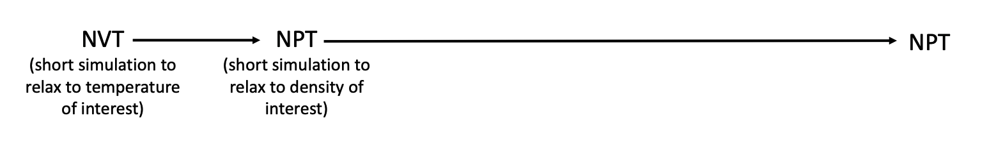
Volume and pressure equilibration
Steps until production:
Production ensemble
Minimisation
Living J.Comp.Mol.Sci. 2019,1,5957

Slide 18
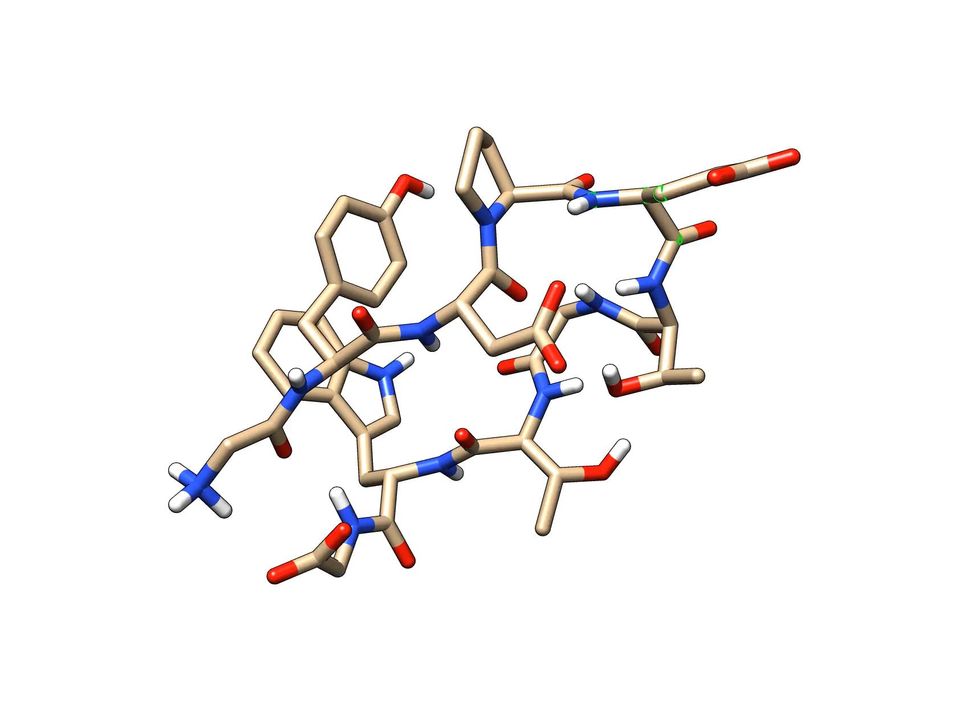
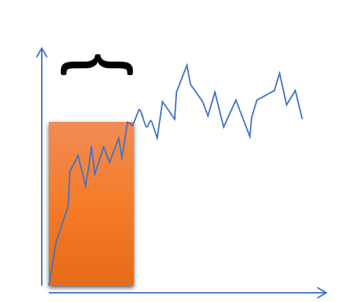
What do we mean by equilibration?
Equilibration/relaxation
RMSD
Temperature/pressure
Time

Slide 19
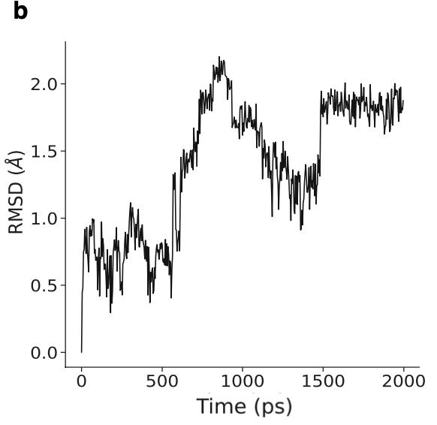
What is RMSD?
$$RMSD=\sqrt{\frac{1}{N}\overset{N}{\underset{i=0}{∑}}(v_{i}-w_{i})^{2}}$$

Slide 20
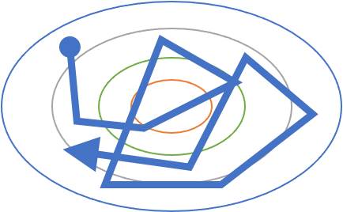
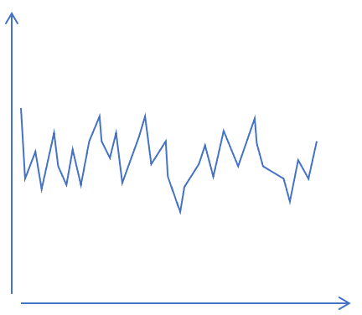
An MD walker over a potential energy surface
$$RMSD=\sqrt{\frac{1}{N}\overset{N}{\underset{i=0}{∑}}(v_{i}-w_{i})^{2}}$$
RMSD
Time

Slide 21
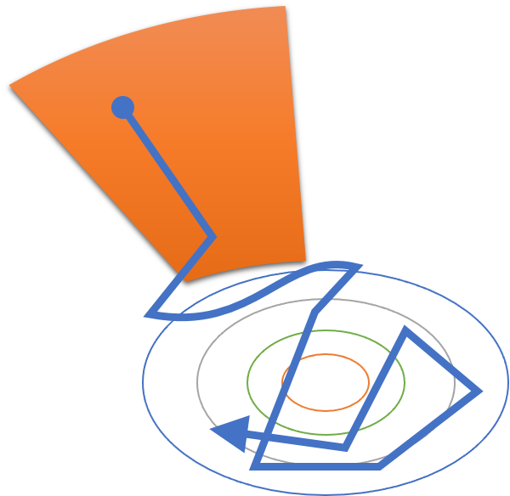
An MD walker over a potential energy surface
Equilibration/relaxation
RMSD
Temperature/pressure
Time

Slide 22
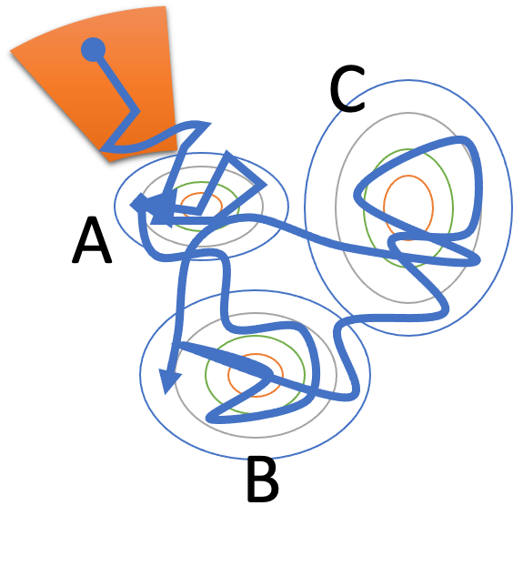
An MD walker over a potential energy surface
B
D
C
A

Slide 23
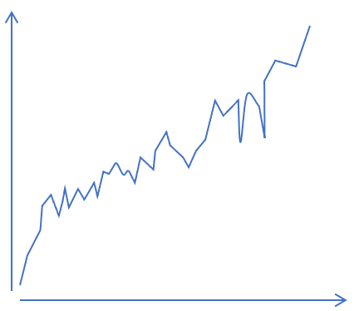
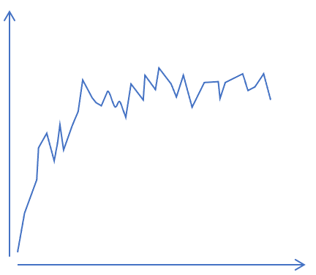
RMSD plots are of limited value
RMSD
RMSD
Time
Time
This is definitely bad
This is not necessarily good

Slide 24
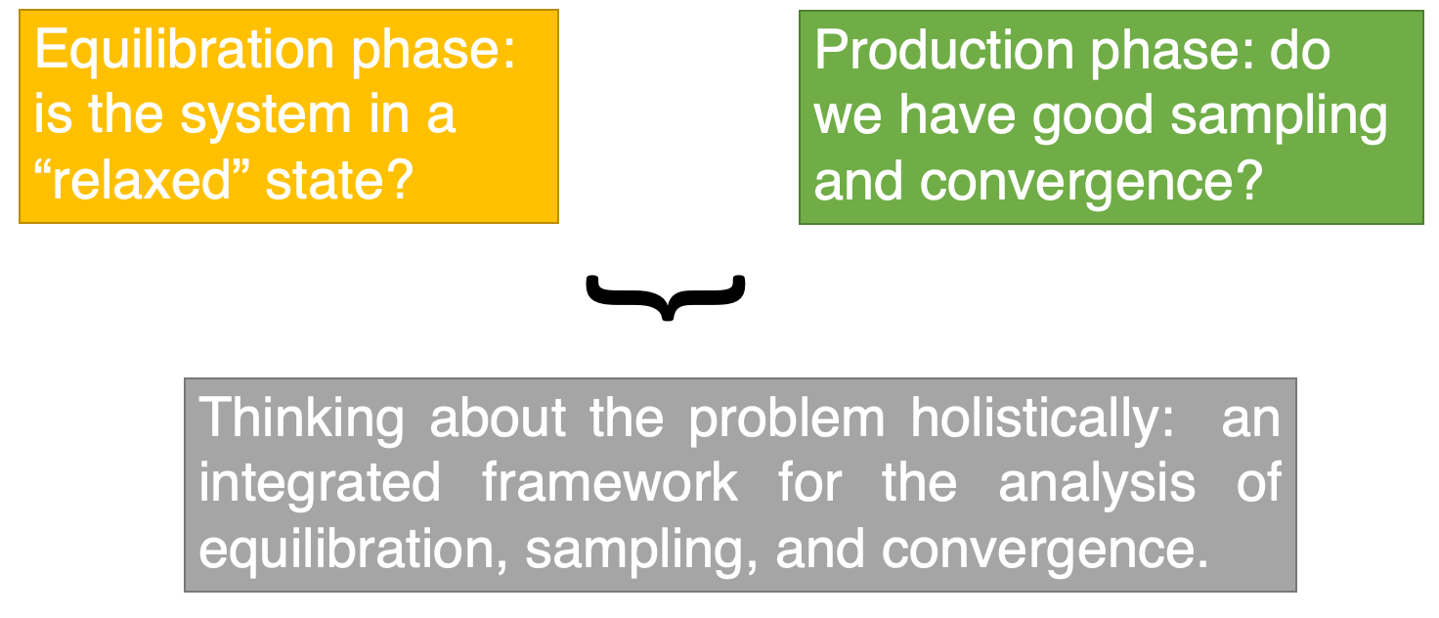
How to best assess equilibration then?

Slide 25
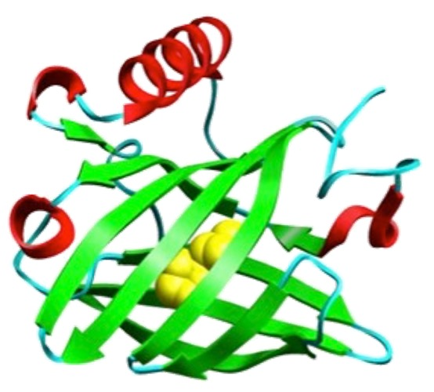
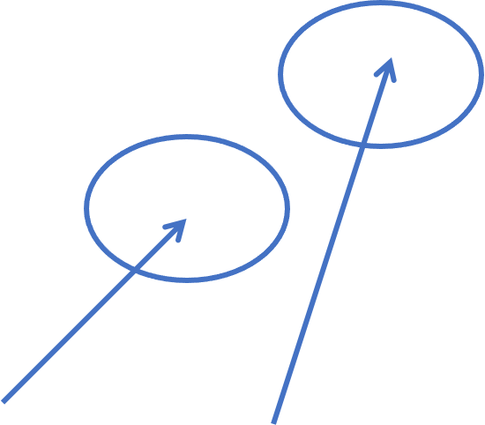
Not all parts of a protein relax in the same way
Typically:
The core relaxes faster than the surface
The main chain relaxes faster than side chains
Helices and sheets relax faster than unstructured elements
If you are interested in this
You may not need to worry so much about this

Slide 26
Use metrics of interest to assess simulation
$$RMSD=\sqrt{\frac{1}{N}\overset{N}{\underset{i=0}{∑}}(v_{i}-w_{i})^{2}}$$
$$R_{g}(x)=\sqrt{\frac{∑_{i}m_{i}r_{i}(y)^{2}+m_{i}r_{i}(z)^{2}}{\sum_{i}{m_{i}}}}$$
Average distance between atoms…
If you are interested in this
You may not need to worry so much about this

Slide 27
Get protein structure
Prep for simulation
Simulation setup
Part III: Introduction to MDAnalysis for simulation analysis
Run Simulation Protocol
Try at home
Simulation Analysis

